Slide 1
ANALYTICAL AND VISUALISATION CRITIQUE PRESENTATION
Presented by : Shashank R
Student Id : 730074631
Subject Code : BEMM461
MSc in Business Analytics

Slide 2

Foreshadow Of Visualization
Graph taken from reddit.com
Targeted audience are cricket fans and enthusiastic analyst.
Mainly focusing on team India’s performance in test cricket format across the years.

Slide 3
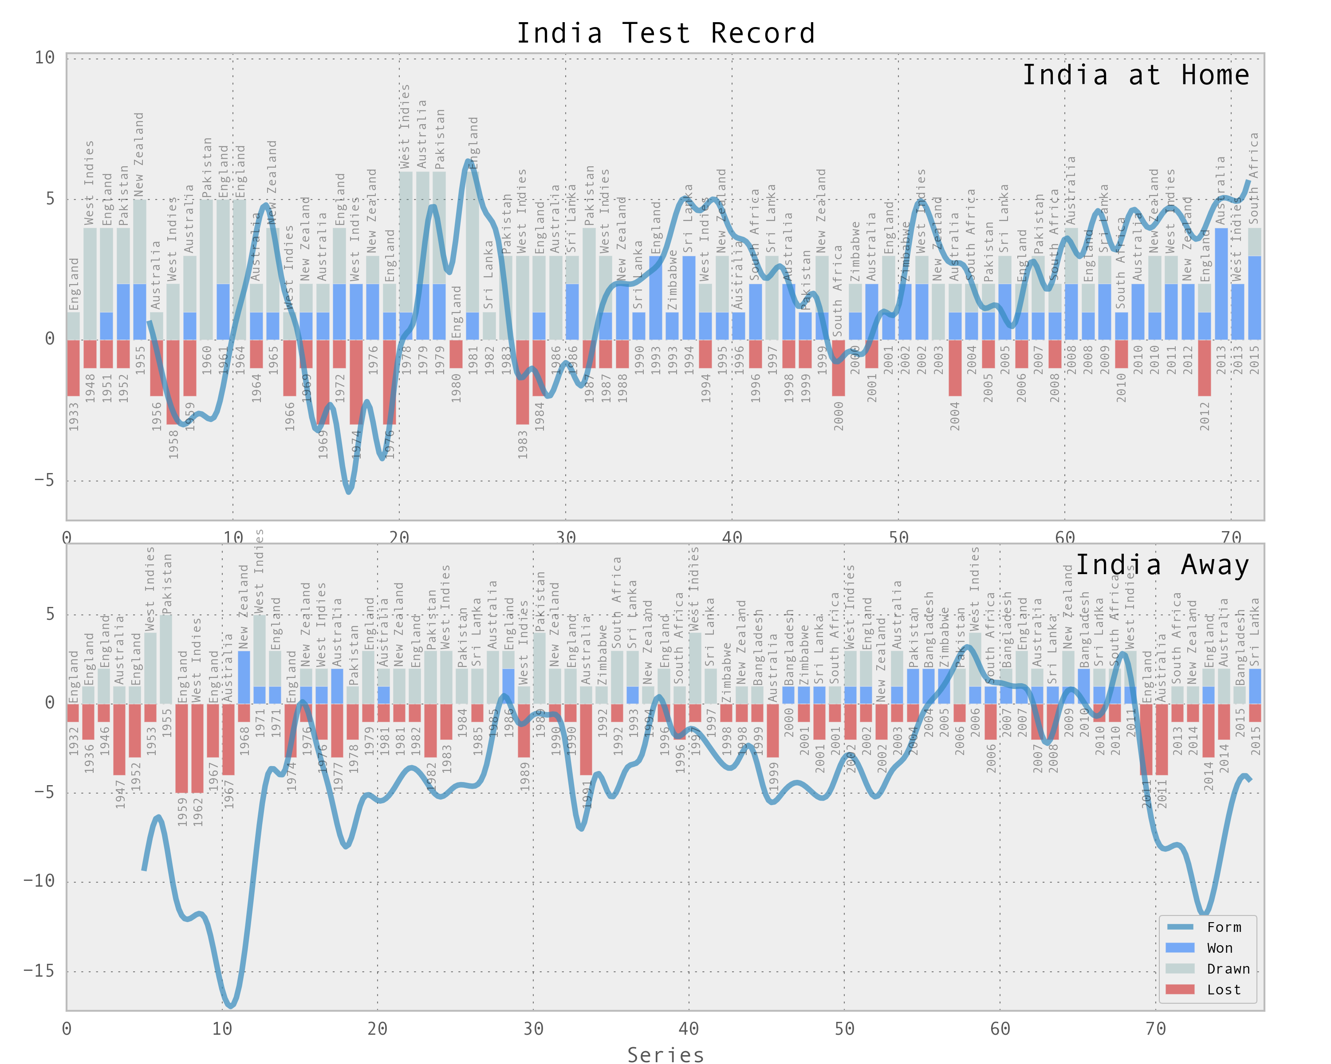
Selected Visualization
Source :https://www.reddit.com/r/Cricket/comments/499uhs/indias_test_record_data_visualization/?rdt=56216

Slide 4
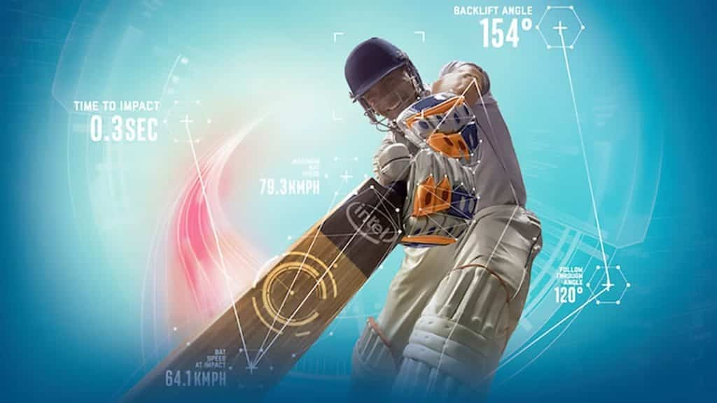
General Characteristics Observed
Everyday data viz
Author-driven narrative
Falls under system 2 thinking according to Kahneman’s dual process theory.

Slide 5
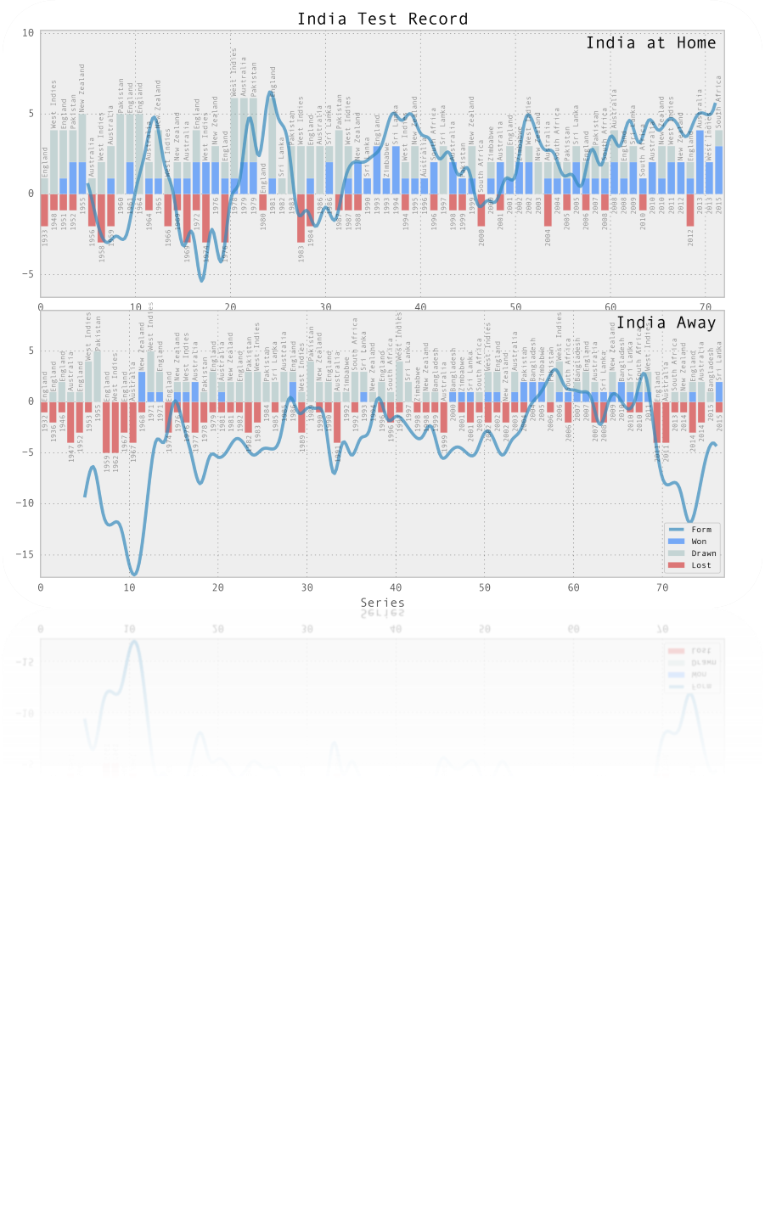
Strengths of visualization
Graph titled "India Test Records," highlighting the team's journey in test cricket.
Preattentive processing: Color hue and intensity is powerful catalyst for quick differentiation.
Evokes emotions: Story sticks to the viewers mind.
The incorporation of delineation lines to showcase the form of team during specific series.
Huge volume of data in a small space.

Slide 6
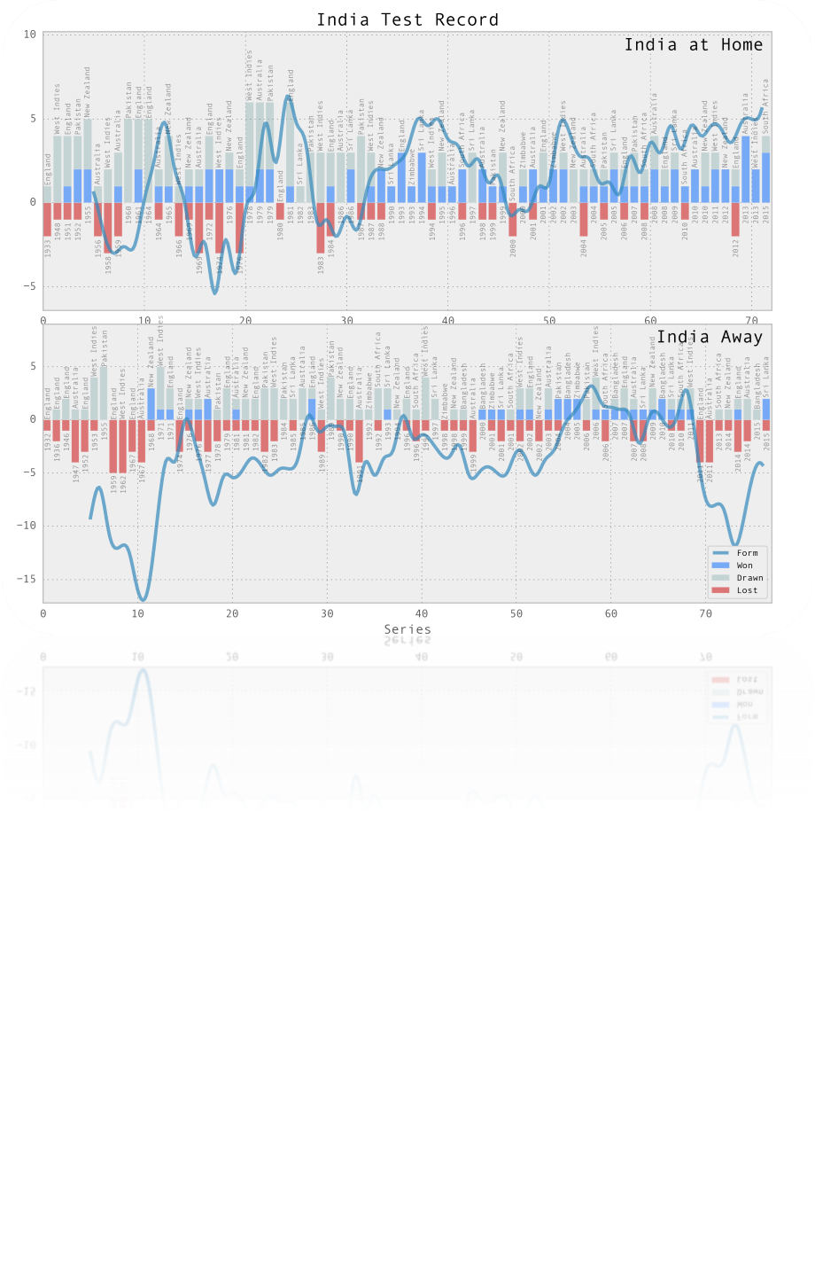
Weakness Of Visualization
Delineation of ‘form’ does not originate from the starting point of the graph.
Utilization of dim colors which is impeding the readability.
Cognitive overload of data.(Cowan’s 2001 on human working memory)
Specific time periods or series not being depicted.
There is no mention on what Y-axis depicts.

Slide 7
Recommendation
Addressing the issue on the color contrast which matches with the background of the graph.(Edwin Tufte data ink ratio)
Usage of more contrasting color and bold fonts enhancing the clarity and accessibility.
Resolving cognitive load: Chunking the data into shorter segments and depicting the result against specific opponents.()
Addressing the disparity on the starting point of the years and the total number of series taken.

Slide 8
References
https://www.cambridge.org/
https://www.codeconquest.com/
https://www.reddit.com/
www.quora.com(BCCI logo)
Edward Tufte's principles.
Nelson Cowan(2001,The magical number 4 in short-term memory))
Scott Berinato 4 types of information visuals

